Slide 1
Loan Repayment Prediction Model
Data-Driven Insights for Financial Services
By dEEPAK DESALE
Notes:
Slide 1: Title Slide "Hello, everyone! I'm Deepak Desale, and today I'm excited to share with you our project on Predicting Loan Repayment using Machine Learning. Let's dive into how we tackled this important financial challenge."

Slide 2
Introduction
Challenge: Determining the likelihood of loan repayment is crucial for financial institutions to minimize risk.
Objective: Develop a predictive model to accurately forecast loan repayment outcomes.
Impact: Enhance decision-making processes for loan approvals and risk management.
Notes:
Slide 2: Introduction "In the financial world, assessing the risk of loan default is crucial. Our project focuses on developing a model that can predict whether a borrower will repay a loan. This capability is vital for banks and lenders to make informed decisions and manage risk effectively."

Slide 3
Dataset Overview
Source: Data was given by upGrad team over email as train and test data in CSV form.
Composition: Dataset comprises borrower details such as annual income, employment length, home ownership status, FICO scores, loan amounts, and loan repayment status.
Size: Analyzed over 100,000 loan records to predict repayment likelihood.
Notes:
Slide 3: Dataset Overview "We used a comprehensive dataset for this project, containing around 100,000 records. It includes various borrower details, such as annual income, employment length, and FICO scores, alongside their loan repayment status."

Slide 4
Data Preprocessing
Missing Data: Applied median imputation for numerical features and 'Unknown' for missing categorical values.
Outliers: Identified and capped outliers in features like annual_inc and loan_amnt using the Interquartile Range (IQR) method to reduce skewness.
Notes:
Slide 4: Data Preprocessing "Data quality is key for accurate predictions. We tackled missing values by imputing them and addressed outliers that could skew our model's performance. These steps ensured our data was clean and ready for analysis."

Slide 5
Feature Engineering
New Features:
income_to_loan_ratio: Highlighting the burden of the loan relative to income.
credit_history_length: Capturing credit reliability over time.
fico_score_average: Simplifying credit assessment with an average score.
Rationale: Enhanced model's ability to capture nuances affecting loan repayment.
Notes:
Slide 5: Feature Engineering "To enhance our model, we engineered features like 'income_to_loan_ratio' and 'credit_history_length'. These new features give our model additional insights into each borrower's financial situation and creditworthiness."

Slide 6
Model Selection
Choice of Model: Selected XGBoost for its robustness to outliers, handling of mixed-type data, and effectiveness with imbalanced datasets.
Handling Imbalance: Utilized scale_pos_weight to balance the skewed distribution of 'Paid' vs. 'Defaulted' outcomes.
Notes:
Slide 6: Model Selection "We chose XGBoost for its excellence in handling diverse datasets and imbalanced classes. To counter the imbalance between 'Paid' and 'Defaulted' loans, we adjusted the 'scale_pos_weight' parameter, balancing our model's focus."

Slide 7
Hyperparameter Tuning
Approach: Employed RandomizedSearchCV for efficient exploration of the parameter space.
Key Parameters Tuned: n_estimators, max_depth, learning_rate, subsample, and colsample_bytree.
Outcome: Achieved optimal model performance with fine-tuned parameters.
Notes:
Slide 7: Hyperparameter Tuning "Finding the right settings for our model was critical. Through RandomizedSearchCV, we tuned parameters such as 'n_estimators' and 'max_depth', optimizing our model to achieve the best performance."

Slide 8

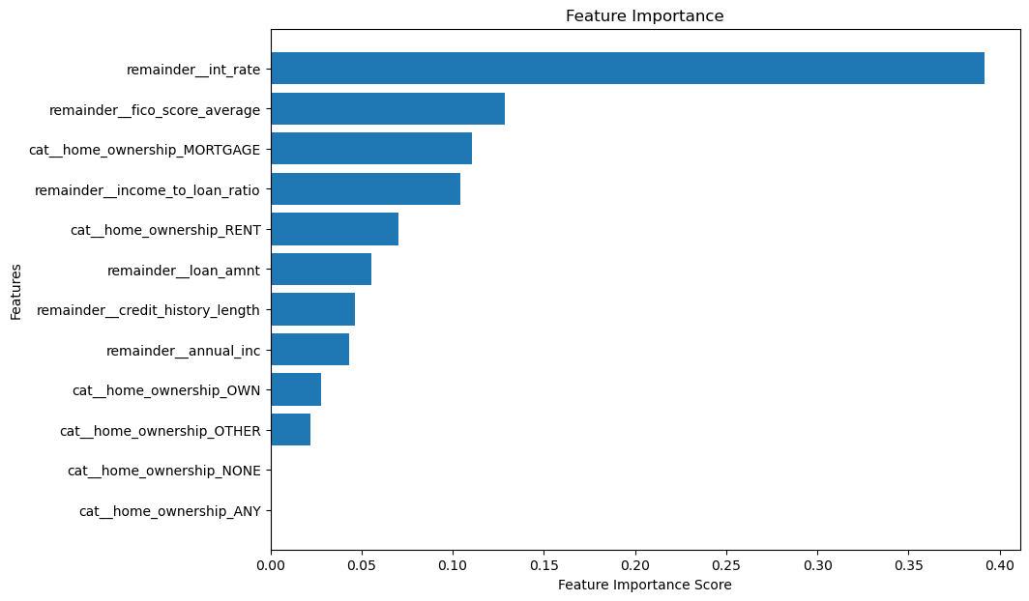
Feature Importance Analysis
Top Predictors: Interest rate (int_rate), average FICO score (fico_score_average), and loan amount (loan_amnt) were identified as significant predictors.
Insights: Demonstrates the importance of creditworthiness and loan characteristics in predicting repayment.
Notes:
Slide 8: Feature Importance Analysis "Our analysis revealed key predictors of loan repayment, including the interest rate and FICO score. Understanding these factors helps us grasp what influences loan repayment outcomes."

Slide 9
Model Performance
AUC-ROC Score: Achieved a score of 0.702, indicating a good predictive ability of the model.
Evaluation: The score reflects the model's effectiveness in distinguishing between the 'Paid' and 'Defaulted' classes.
Notes:
Slide 9: Model Performance "Our optimized model achieved an AUC-ROC score of 0.702, demonstrating its strong ability to differentiate between borrowers likely to repay or default on their loans."

Slide 10
Conclusions and Future Work
Summary: Developed a predictive model with robust preprocessing, feature engineering, and model optimization steps.
Impact: The model can significantly aid financial institutions in assessing loan repayment risks.
Next Steps: Explore additional data sources, further refine models with advanced techniques, and consider deployment strategies for real-world applications.
Notes:
Slide 10: Conclusions and Future Work "In summary, our project not only developed a predictive model but also provided insights into crucial factors affecting loan repayment. Looking ahead, we plan to explore additional data sources and refine our model further."

Slide 11
Q&A
"Thank you for your attention. I'm now open to any questions you might have."
Notes:
Slide 11: Q&A "Thank you for watching! I'm open to any questions you might have about the project. Please feel free to ask."

Slide 12
Acknowledgements
Thank you for everyone at upGrad Knowledgehut for giving me this wonderful opportunity work on this project.
Notes:
Slide 12: Acknowledgements "Before we wrap up, I'd like to extend my gratitude to my mentors, peers, and everyone who supported this project. Your guidance was invaluable."

Slide 13
Contact Information
LinkedIN- www.linkedin.com/in/deepakvdesale
Email- evergreendeepakdesale@gmail.com
Github- https://github.com/deepakdesale
Notes:
Slide 13: Contact Information "If you have further questions or would like to discuss this project more, here's my contact information. I look forward to connecting with you."

